Slide 1
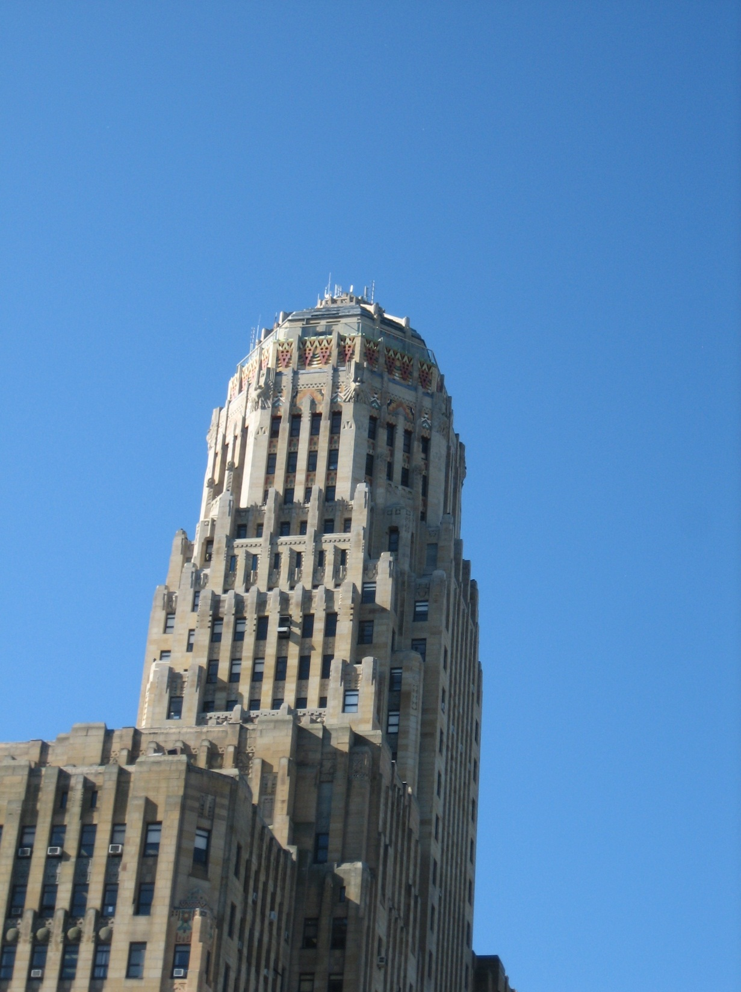
Welcome

Slide 2
Welcome

Slide 3
Commissioners:
Mayor's Appointees
Catherine Gillespie, Chair David Granville Donald J. Siuta James Cooper Thomas Chestnut Kathleen Rooney Susana Tejada
Common Council President's Appointees: Joanna Angie Gerald Mead James Pappas Catherine Linder Spencer Ted Pietrzak Honorary Commissioner: Elisabeth Clarkson

Slide 4
Commissioners:
Mayor's Appointees
Catherine Gillespie, Chair David Granville Donald J. Siuta James Cooper Thomas Chestnut Kathleen Rooney Susana Tejada
Common Council President's Appointees: Joanna Angie Gerald Mead James Pappas Catherine Linder Spencer Ted Pietrzak Honorary Commissioner: Elisabeth Clarkson

Slide 5
The Arts Commission works in a larger context of City support of arts and culture. The City supports such organizations as the Historical Society, Klienhans Music Hall and the Zoo to mention a few

Slide 6
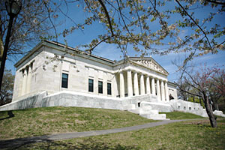
The Arts Commission works in a larger context of City support of arts and culture. The City supports facility improvement at such organizations as the Historical Society, Klienhans Music Hall and the Zoo to mention a few

Slide 7
The Arts Commission works in a larger context of City support of arts and culture. The City supports facility improvement at such organizations as the Historical Society, Klienhans Music Hall and the Zoo to mention a few

Slide 8
The Arts Commission works in a larger context of City support of arts and culture. The City supports facility improvement at such organizations as the Historical Society, Klienhans Music Hall , and the Zoo to mention a few.

Slide 9
Our Responsibilities

Slide 10
§ 6-29. Powers and duties.
A. The Buffalo Arts Commission shall have the power and it shall be its duty to:
(1) Annually submit to the Mayor and Common Council the Commission's plan for the expenditure of funds commissioning new works of art in the City of Buffalo.
(2) Advise the Mayor and Common Council concerning works of art to be acquired by the City, whether by purchase, gift or otherwise, together with their proposed location.
(3) Recommend to the Mayor and Common Council suitable practices and procedures for the cataloging, care and maintenance of all works of art belonging to the City of Buffalo.
(4) Make periodic reviews, at least annually, of all City capital improvement projects with the Mayor for the purpose of making recommendations to the City as to appropriations for works of art.
(5) Annually submit a capital budget request equal to or no less than 1% of the City's projected capital improvement budget based on the following:
[Added 4-2-1991, Editor's Note: This ordinance was passed after veto 4-16-1991. It also provided that former Subsection A(5) through (8) should be renumbered as Subsection A(6) through (9). effective 4-16-1991 ]
(a) The Commission's plans for the conservation of City-owned works of art;
(b) Plans to commission new works of art; and
(c) The Commission's review and recommendations of projects enhancing the general aesthetic appearance of City property.
(6) Advise the Mayor and Common Council concerning the removal or relocation of any works of art presently owned by the City of Buffalo.
(7) Advise the Mayor and Common Council concerning the acceptance or declination of works of art offered to the City of Buffalo.
(8) Make application for and administer federal, state and other grants, loans or appropriations for the Commission's acquisition or maintenance of works of art.
(9) Assist the City in the formation of City ordinances and policies designed to promote, enhance and strengthen the arts in Buffalo.

Slide 11
Some of the responsibilities and duties of the Buffalo Arts Commission
1. The Commission's plans for the conservation of City-owned works of art;
2. Plans to commission new works of art; and
3. The Commission's reviews and recommendations of projects enhancing the general aesthetic appearance of City property.
4. Advises the Mayor and Common Council concerning the removal or relocation of any works of art presently owned by the City of Buffalo.
5. Advises the Mayor and Common Council concerning the acceptance or declination of works of art offered to the City of Buffalo.
6. Makes application for and administer federal, state and other grants, loans or appropriations for the Commission's acquisition or maintenance of works of art.
7. Assists the City in the formation of City ordinances and policies designed to promote, enhance and strengthen the arts in Buffalo.

Slide 12
Some of the responsibilities and duties of the Buffalo Arts Commission
1. The Commission plans for the conservation of City-owned works of art;
2. Plans to commission new works of art; and
3. The Commission's reviews and recommendations of projects enhancing the general aesthetic appearance of City property.
4. Advises the Mayor and Common Council concerning the removal or relocation of any works of art presently owned by the City of Buffalo.
5. Advises the Mayor and Common Council concerning the acceptance or declination of works of art offered to the City of Buffalo.
6. Makes application for and administer federal, state and other grants, loans or appropriations for the Commission's acquisition or maintenance of works of art.
7. Assists the City in the formation of City ordinances and policies designed to promote, enhance and strengthen the arts in Buffalo.

Slide 13
Some of the responsibilities and duties of the Buffalo Arts Commission
The Commission plans for the conservation of City-owned works of art;
2. Plans to commission new works of art; and
3. The Commission's reviews and recommendations of projects enhancing the general aesthetic appearance of City property.
4. Advises the Mayor and Common Council concerning the removal or relocation of any works of art presently owned by the City of Buffalo.
5. Advises the Mayor and Common Council concerning the acceptance or declination of works of art offered to the City of Buffalo.
6. Makes application for and administer federal, state and other grants, loans or appropriations for the Commission's acquisition or maintenance of works of art.
7. Assists the City in the formation of City ordinances and policies designed to promote, enhance and strengthen the arts in Buffalo.

Slide 14
Some of the responsibilities and duties of the Buffalo Arts Commission
1. The Commission plans for the conservation of City-owned works of art;
2. Plans to commission new works of art; and
3. The Commission's reviews and recommends projects that enhance the general aesthetic appearance of City property.
4. Advises the Mayor and Common Council concerning the removal or relocation of any works of art presently owned by the City of Buffalo.
5. Advises the Mayor and Common Council concerning the acceptance or declination of works of art offered to the City of Buffalo.
6. Makes application for and administer federal, state and other grants, loans or appropriations for the Commission's acquisition or maintenance of works of art.
7. Assists the City in the formation of City ordinances and policies designed to promote, enhance and strengthen the arts in Buffalo.

Slide 15
Some of the responsibilities and duties of the Buffalo Arts Commission
1. The Commission plans for the conservation of City-owned works of art;
2. Plans to commission new works of art; and
3. The Commission's reviews and recommends projects that enhance the general aesthetic appearance of City property.
4. Advises the Mayor and Common Council concerning the removal or relocation of any works of art presently owned by the City of Buffalo.
5. Advises the Mayor and Common Council concerning the acceptance or declination of works of art offered to the City of Buffalo.
6. Makes application for and administer federal, state and other grants, loans or appropriations for the Commission's acquisition or maintenance of works of art.
7. Assists the City in the formation of City ordinances and policies designed to promote, enhance and strengthen the arts in Buffalo.

Slide 16
Some of the responsibilities and duties of the Buffalo Arts Commission
1. Plans for the conservation of City-owned works of art;
2. Plans to commission new works of art; and
3. The Commission's reviews and recommends projects that enhance the general aesthetic appearance of City property.
4. Advises the Mayor and Common Council concerning the removal or relocation of any works of art presently owned by the City of Buffalo.
5. Advises the Mayor and Common Council concerning the acceptance or declination of works of art offered to the City of Buffalo.
6. Makes application for and administer federal, state and other grants, loans or appropriations for the Commission's acquisition or maintenance of works of art.
7. Assists the City in the formation of City ordinances and policies designed to promote, enhance and strengthen the arts in Buffalo.

Slide 17
Some of the responsibilities and duties of the Buffalo Arts Commission
1. The Commission plans for the conservation of City-owned works of art;
2. Plans to commission new works of art; and
3. The Commission's reviews and recommends projects that enhance the general aesthetic appearance of City property.
4. Advises the Mayor and Common Council concerning the removal or relocation of any works of art presently owned by the City of Buffalo.
5. Advises the Mayor and Common Council concerning the acceptance or declination of works of art offered to the City of Buffalo.
6. Makes application for, and administers federal, state and other grants, loans or appropriations for the Commission's acquisition or maintenance of works of art.
7. Assists the City in the formation of City ordinances and policies designed to promote, enhance and strengthen the arts in Buffalo.

Slide 18
Some of the responsibilities and duties of the Buffalo Arts Commission
1. The Commission plans for the conservation of City-owned works of art;
2. Plans to commission new works of art; and
3. The Commission's reviews and recommends projects that enhance the general aesthetic appearance of City property.
4. Advises the Mayor and Common Council concerning the removal or relocation of any works of art presently owned by the City of Buffalo.
5. Advises the Mayor and Common Council concerning the acceptance or declination of works of art offered to the City of Buffalo.
6. Makes application for and administers federal, state and other grants, loans or appropriations for the Commission's acquisition or maintenance of works of art.
7. Assists the City in the formation of City ordinances and policies designed to promote, enhance and strengthen the arts in Buffalo.

Slide 19
Promote the artistic life of city neighborhoods with particular attention paid to preserving and promoting cultural diversity

Slide 20
POLICY AND PROCEDURE FOR PLACEMENT OF PUBLIC ART ON CITY PROPERTY (selected text)
PURPOSE
Art can take many forms, from traditional statuary and painting, to temporary installations and exhibits, and out-of-the-ordinary applications such as unique designs and material applied to public spaces, buildings or fixtures. This may include signs, plaques, utilitarian objects such as benches, bike racks, light fixtures, and water fountains, monuments, and memorials.

Slide 21
POLICY AND PROCEDURE FOR PLACEMENT OF PUBLIC ART ON CITY PROPERTY (selected text)
PURPOSE
Art can take many forms, from traditional statuary and painting, to temporary installations and exhibits, and out-of-the-ordinary applications such as unique designs and material applied to public spaces, buildings or fixtures. This may include signs, plaques, utilitarian objects such as benches, bike racks, light fixtures, and water fountains, monuments, and memorials.

Slide 22
POLICY AND PROCEDURE FOR PLACEMENT OF PUBLIC ART ON CITY PROPERTY (selected text)
PURPOSE
Art can take many forms, from traditional statuary and painting, to temporary installations and exhibits, and out-of-the-ordinary applications such as unique designs and material applied to public spaces, buildings or fixtures. This may include signs, plaques, utilitarian objects such as benches, bike racks, light fixtures, and water fountains, monuments, and memorials.

Slide 23
POLICY AND PROCEDURE FOR PLACEMENT OF PUBLIC ART ON CITY PROPERTY (selected text)
PURPOSE
Art can take many forms, from traditional statuary and painting, to temporary installations and exhibits, and out-of-the-ordinary applications such as unique designs and material applied to public spaces, buildings or fixtures. This may include signs, plaques, utilitarian objects such as benches, bike racks, light fixtures, and water fountains, monuments, and memorials.

Slide 24
OBJECTIVES
Arts Commission review is designed to assure that public art reflects the highest standards of artistic achievement, that works are placed in appropriate settings, and that they do not offend Buffalo’s community standards of propriety in civic art.
ONSIDE

Slide 25
OBJECTIVES
Arts Commission review is designed to assure that public art reflects the highest standards of artistic achievement, that works are placed in appropriate settings, and that they do not offend Buffalo’s community standards of propriety in civic art.
ONSIDE

Slide 26
OBJECTIVES
Arts Commission review is designed to assure that public art reflects the highest standards of artistic achievement, that works are placed in appropriate settings, and that they do not offend Buffalo’s community standards of propriety in civic art.
ONSIDE

Slide 27
OBJECTIVES
Arts Commission review is designed to assure that public art reflects the highest standards of artistic achievement, that works are placed in appropriate settings, and that they do not offend Buffalo’s community standards of propriety in civic art.
ONSIDE

Slide 28
CONSIDERATIONS
Artistic Merit
Appropriate Placement
Community Standards
Preservation and Maintenances
SPECIAL CONSIDERATIONS FOR MONUMENTS AND MEMORIALS
Historical Markers
War and Veterans Memorials
Police and Fire Memorials
SIGNAGE/BANNERS
PUBLIC ART IN PARKS
Olmsted Parks
Other Historic Parks
All Other Parks

Slide 29
CONSIDERATIONS
Artistic Merit
Appropriate Placement
Community Standards
Preservation and Maintenances
SPECIAL CONSIDERATIONS FOR MONUMENTS AND MEMORIALS
Historical Markers
War and Veterans Memorials
Police and Fire Memorials
SIGNAGE/BANNERS
PUBLIC ART IN PARKS
Olmsted Parks
Other Historic Parks
All Other Parks

Slide 30
CONSIDERATIONS
Artistic Merit
Appropriate Placement
Community Standards
Preservation and Maintenances
SPECIAL CONSIDERATIONS FOR MONUMENTS AND MEMORIALS
Historical Markers
War and Veterans Memorials
Police and Fire Memorials
SIGNAGE/BANNERS
PUBLIC ART IN PARKS
Olmsted Parks
Other Historic Parks
All Other Parks

Slide 31
CONSIDERATIONS
Artistic Merit
Appropriate Placement
Community Standards
Preservation and Maintenances
SPECIAL CONSIDERATIONS FOR MONUMENTS AND MEMORIALS
Historical Markers
War and Veterans Memorials
Police and Fire Memorials
SIGNAGE/BANNERS
PUBLIC ART IN PARKS
Olmsted Parks
Other Historic Parks
All Other Parks

Slide 32
CONSIDERATIONS
Artistic Merit
Appropriate Placement
Community Standards
Preservation and Maintenance
SPECIAL CONSIDERATIONS FOR MONUMENTS AND MEMORIALS
Historical Markers
War and Veterans Memorials
Police and Fire Memorials
SIGNAGE/BANNERS
PUBLIC ART IN PARKS
Olmsted Parks
Other Historic Parks
All Other Parks

Slide 33
CONSIDERATIONS
Artistic Merit
Appropriate Placement
Community Standards
Preservation and Maintenance
SPECIAL CONSIDERATIONS FOR MONUMENTS AND MEMORIALS
Historical Markers
War and Veterans Memorials
Police and Fire Memorials
SIGNAGE/BANNERS
PUBLIC ART IN PARKS
Olmsted Parks
Other Historic Parks
All Other Parks

Slide 34
CONSIDERATIONS
Artistic Merit
Appropriate Placement
Community Standards
Preservation and Maintenance
SPECIAL CONSIDERATIONS FOR MONUMENTS AND MEMORIALS
Historical Markers
War and Veterans Memorials
Police and Fire Memorials
SIGNAGE/BANNERS
PUBLIC ART IN PARKS
Olmsted Parks
Other Historic Parks
All Other Parks

Slide 35
CONSIDERATIONS
Artistic Merit
Appropriate Placement
Community Standards
Preservation and Maintenance
SPECIAL CONSIDERATIONS FOR MONUMENTS AND MEMORIALS
Historical Markers
War and Veterans Memorials
Police and Fire Memorials
SIGNAGE/BANNERS
PUBLIC ART IN PARKS
Olmsted Parks
Other Historic Parks
All Other Parks

Slide 36
CONSIDERATIONS
Artistic Merit
Appropriate Placement
Community Standards
Preservation and Maintenance
SPECIAL CONSIDERATIONS FOR MONUMENTS AND MEMORIALS
Historical Markers
War and Veterans Memorials
Police and Fire Memorials
SIGNAGE/BANNERS
PUBLIC ART IN PARKS
Olmsted Parks
Other Historic Parks
All Other Parks

Slide 37
CONSIDERATIONS
Artistic Merit
Appropriate Placement
Community Standards
Preservation and Maintenance
SPECIAL CONSIDERATIONS FOR MONUMENTS AND MEMORIALS
Historical Markers
War and Veterans Memorials
Police and Fire Memorials
SIGNAGE/BANNERS
PUBLIC ART IN PARKS
Olmsted Parks
Other Historic Parks
All Other Parks

Slide 38
CONSIDERATIONS
Artistic Merit
Appropriate Placement
Community Standards
Preservation and Maintenance
SPECIAL CONSIDERATIONS FOR MONUMENTS AND MEMORIALS
Historical Markers
War and Veterans Memorials
Police and Fire Memorials
SIGNAGE/BANNERS
PUBLIC ART IN PARKS
Olmsted Parks
Other Historic Parks
All Other Parks

Slide 39
CONSIDERATIONS
Artistic Merit
Appropriate Placement
Community Standards
Preservation and Maintenances
SPECIAL CONSIDERATIONS FOR MONUMENTS AND MEMORIALS
Historical Markers
War and Veterans Memorials
Police and Fire Memorials
SIGNAGE/BANNERS
PUBLIC ART IN PARKS
Olmsted Parks
Other Historic Parks
All Other Parks

Slide 40
CONSIDERATIONS
Artistic Merit
Appropriate Placement
Community Standards
Preservation and Maintenance
SPECIAL CONSIDERATIONS FOR MONUMENTS AND MEMORIALS
Historical Markers
War and Veterans Memorials
Police and Fire Memorials
SIGNAGE/BANNERS
PUBLIC ART IN PARKS
Olmsted Parks
Other Historic Parks
All Other Parks

Slide 41
CONSIDERATIONS
Artistic Merit
Appropriate Placement
Community Standards
Preservation and Maintenance
SPECIAL CONSIDERATIONS FOR MONUMENTS AND MEMORIALS
Historical Markers
War and Veterans Memorials
Police and Fire Memorials
SIGNAGE/BANNERS
PUBLIC ART IN PARKS
Olmsted Parks
Other Historic Parks
All Other Parks

Slide 43
Attending to Conservation

Slide 44
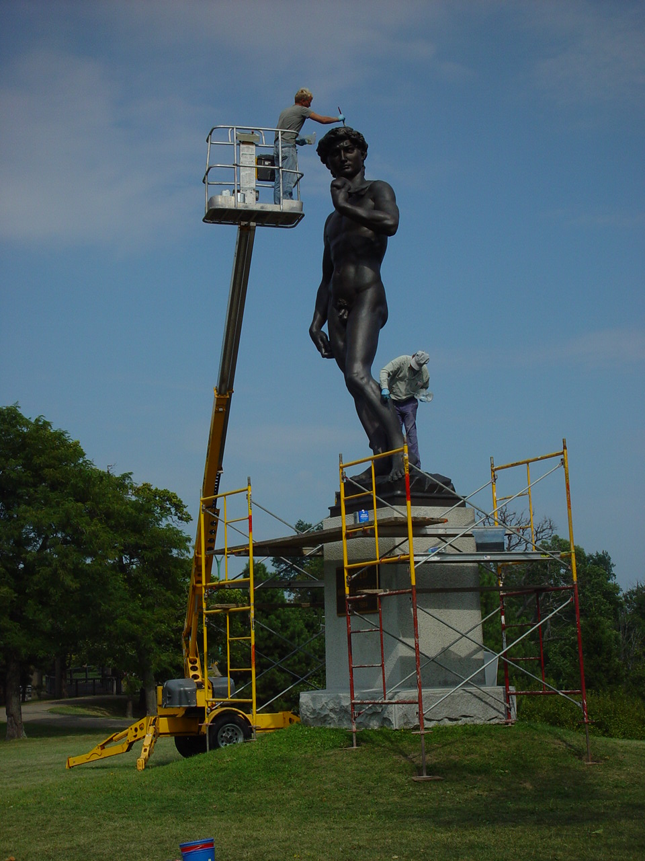

Slide 47
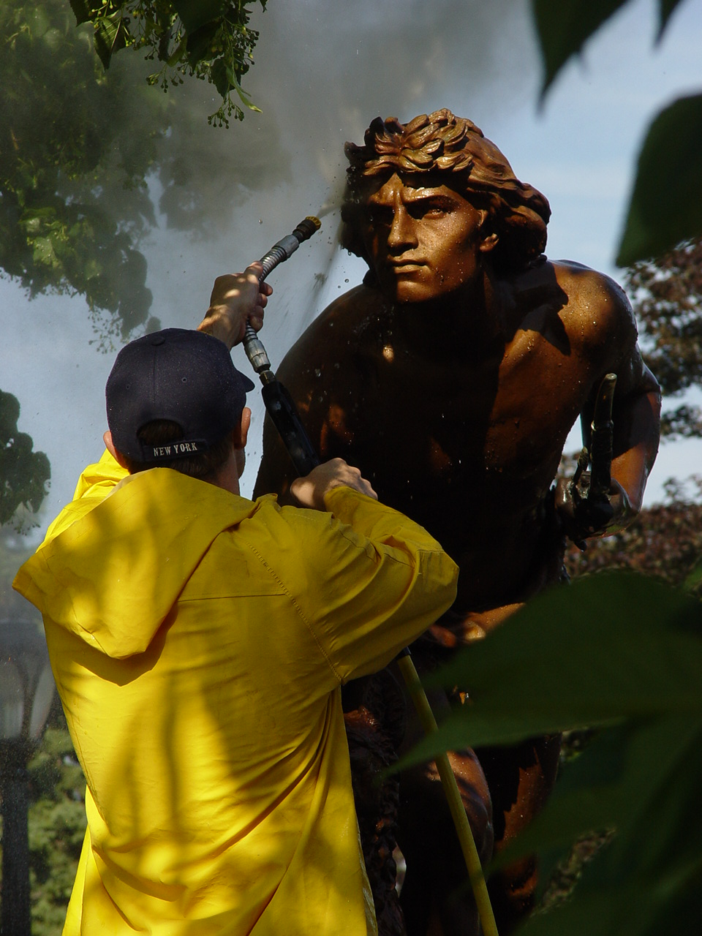

Slide 48
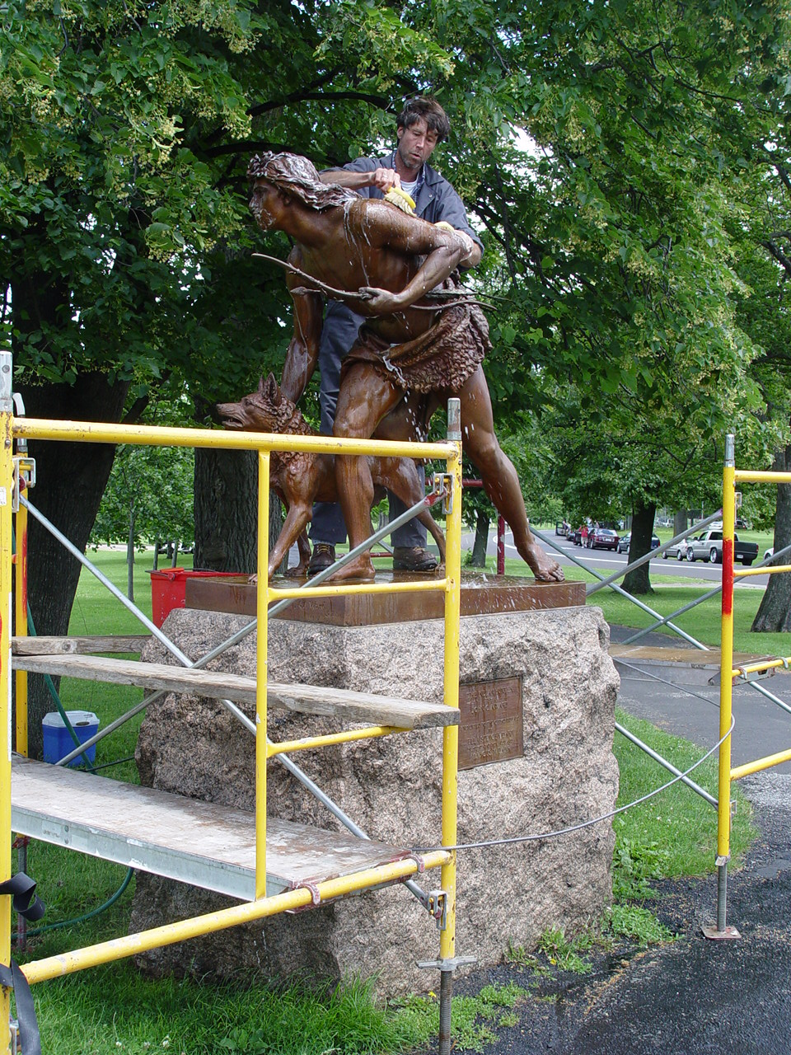

Slide 49
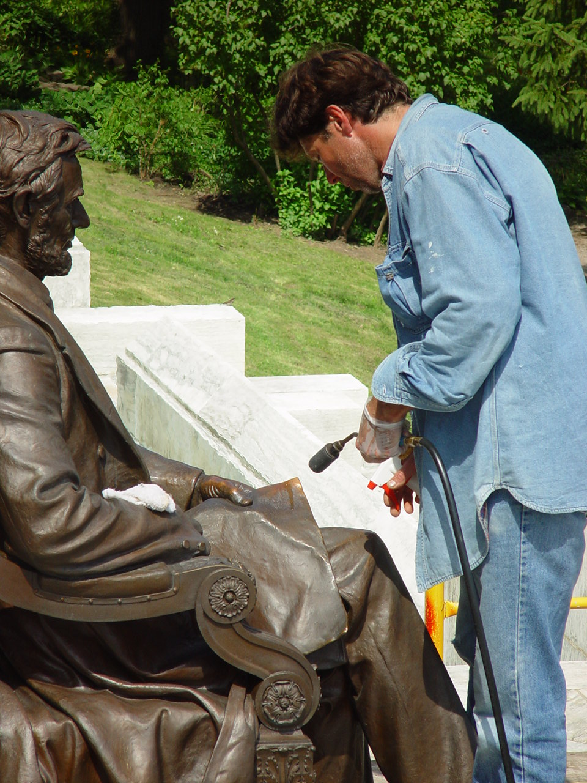

Slide 50
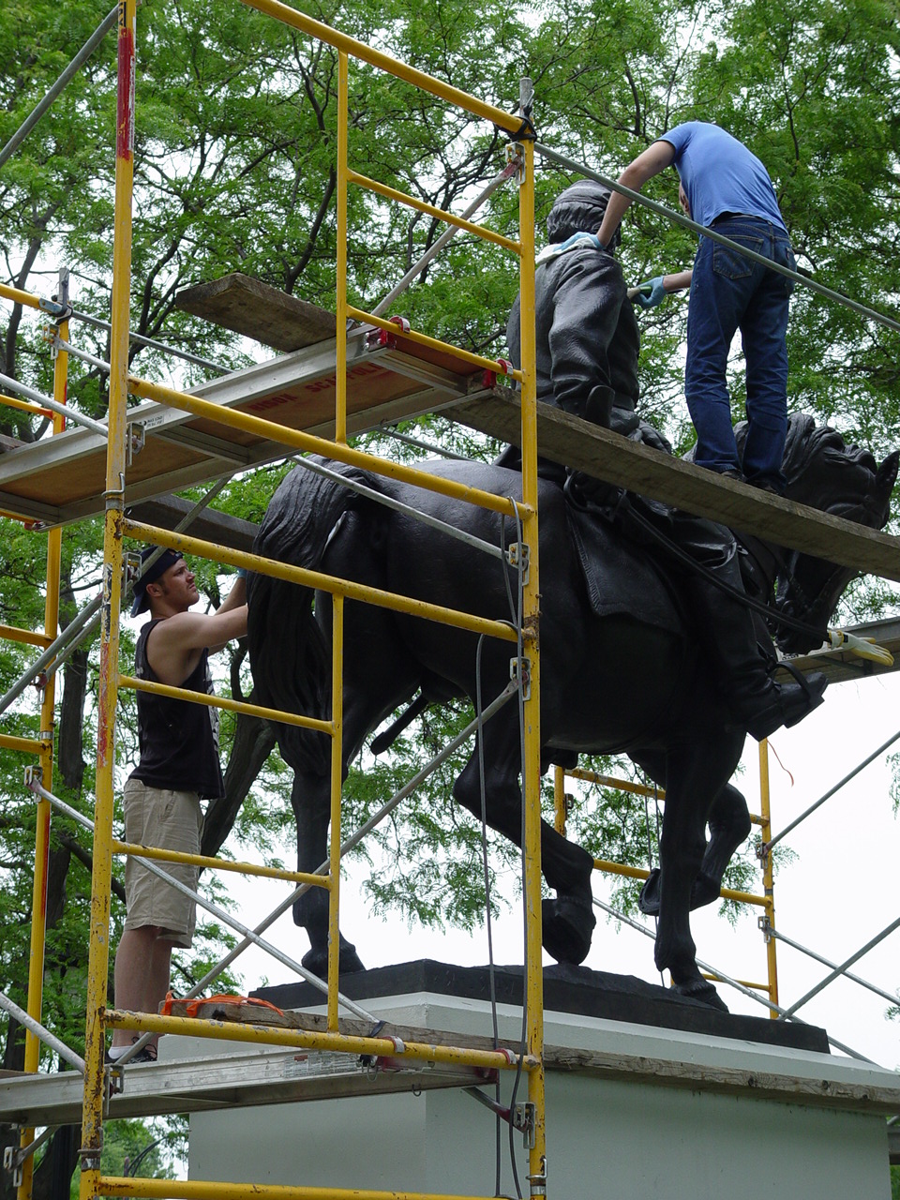

Slide 51
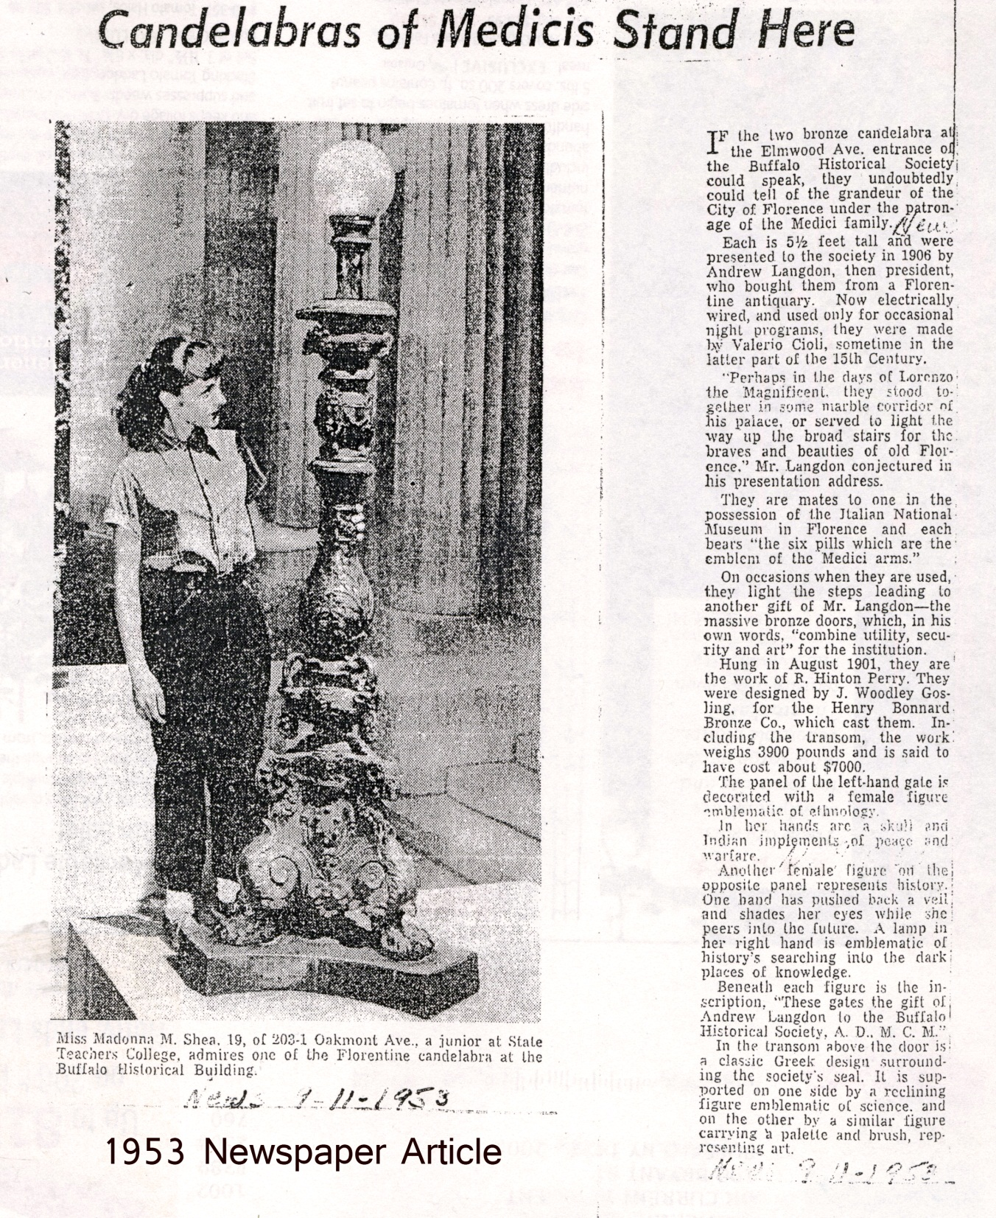

Slide 53
Coordinating Public Art Projects

Slide 54
MAYOR’S COORDINATING COMMITTEE ON CIVIC ART
Because the placement of art in public places involves tremendous cooperation among many parts of City government, the Mayor has determined that is necessary to coordinate the efforts of all parts of city government to facilitate the decision-making process and to aid the citizenry in understanding the public arts process.
Coordinating Committee Membership
The Coordinating Committee shall be comprised on an ad hoc basis depending upon the types of reviews and approvals needed. Units of City government that may be involved include: Buffalo Arts Commission; City Architect; City Engineer; Streets and Sidewalks; Parks; Buildings and Grounds, Planning Division; Planning Board; Preservation Board; other City functions as required.

Slide 55
MAYOR’S COORDINATING COMMITTEE ON CIVIC ART
Because the placement of art in public places involves tremendous cooperation among many parts of City government, the Mayor has determined that is necessary to coordinate the efforts of all parts of city government to facilitate the decision-making process and to aid the citizenry in understanding the public arts process.
Coordinating Committee Membership
The Coordinating Committee shall be comprised on an ad hoc basis depending upon the types of reviews and approvals needed. Units of City government that may be involved include: Buffalo Arts Commission; City Architect; City Engineer; Streets and Sidewalks; Parks; Buildings and Grounds, Planning Division; Planning Board; Preservation Board; other City functions as required.

Slide 56
MAYOR’S COORDINATING COMMITTEE ON CIVIC ART
Because the placement of art in public places involves tremendous cooperation among many parts of City government, the Mayor has determined that is necessary to coordinate the efforts of all parts of city government to facilitate the decision-making process and to aid the citizenry in understanding the public arts process.
Coordinating Committee Membership Includes
Buffalo Arts Commission
Department of Public Works
Parks
Legal Department
Preservation Board;
other City functions as required.

Slide 57
MAYOR’S COORDINATING COMMITTEE ON CIVIC ART
Because the placement of art in public places involves tremendous cooperation among many parts of City government, the Mayor has determined that is necessary to coordinate the efforts of all parts of city government to facilitate the decision-making process and to aid the citizenry in understanding the public arts process.
Coordinating Committee Membership Includes
Buffalo Arts Commission
Department of Public Works
Parks
Legal Department
Preservation Board;
other City functions as required.

Slide 58
MAYOR’S COORDINATING COMMITTEE ON CIVIC ART
Because the placement of art in public places involves tremendous cooperation among many parts of City government, the Mayor has determined that is necessary to coordinate the efforts of all parts of city government to facilitate the decision-making process and to aid the citizenry in understanding the public arts process.
Coordinating Committee Membership Includes
Buffalo Arts Commission
Department of Public Works
Parks
Legal Department
Preservation Board;
other City functions as required.

Slide 59
MAYOR’S COORDINATING COMMITTEE ON CIVIC ART
Because the placement of art in public places involves tremendous cooperation among many parts of City government, the Mayor has determined that is necessary to coordinate the efforts of all parts of city government to facilitate the decision-making process and to aid the citizenry in understanding the public arts process.
Coordinating Committee Membership Includes
Buffalo Arts Commission
Department of Public Works
Parks
Legal Department
Preservation Board;
other City functions as required.

Slide 60
MAYOR’S COORDINATING COMMITTEE ON CIVIC ART
Because the placement of art in public places involves tremendous cooperation among many parts of City government, the Mayor has determined that is necessary to coordinate the efforts of all parts of city government to facilitate the decision-making process and to aid the citizenry in understanding the public arts process.
Coordinating Committee Membership Includes
Buffalo Arts Commission
Department of Public Works
Parks
Legal Department
Preservation Board;
other City functions as required.

Slide 61
MAYOR’S COORDINATING COMMITTEE ON CIVIC ART
Because the placement of art in public places involves tremendous cooperation among many parts of City government, the Mayor has determined that is necessary to coordinate the efforts of all parts of city government to facilitate the decision-making process and to aid the citizenry in understanding the public arts process.
Coordinating Committee Membership Includes
Buffalo Arts Commission
Department of Public Works
Parks
Legal Department
Preservation Board;
other City functions as required.

Slide 62
MAYOR’S COORDINATING COMMITTEE ON CIVIC ART
Because the placement of art in public places involves tremendous cooperation among many parts of City government, the Mayor has determined that is necessary to coordinate the efforts of all parts of city government to facilitate the decision-making process and to aid the citizenry in understanding the public arts process.
Coordinating Committee Membership Includes
Buffalo Arts Commission
Department of Public Works
Parks
Legal Department
Preservation Board;
other City functions as required.

Slide 63
Reviewing and Advising Regarding Public Art

Slide 64
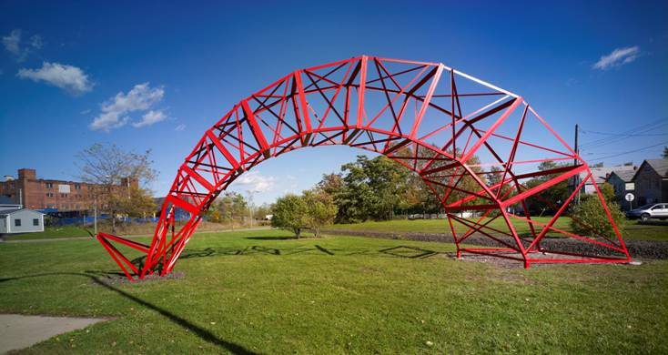

Slide 65
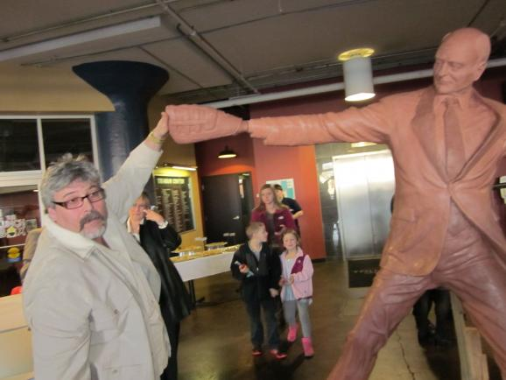

Slide 67
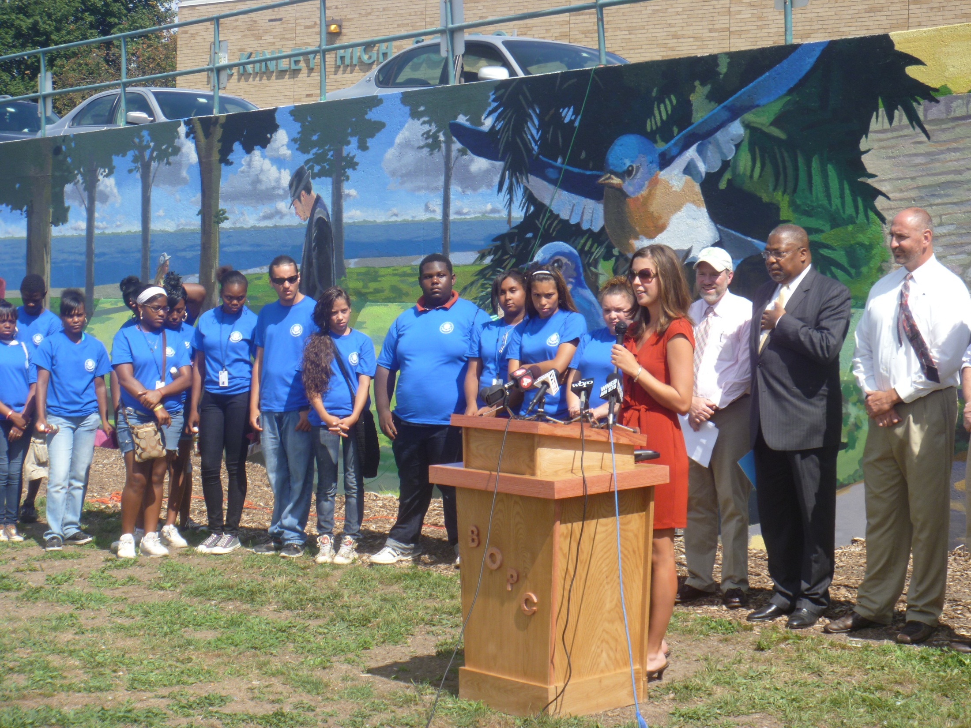

Slide 68
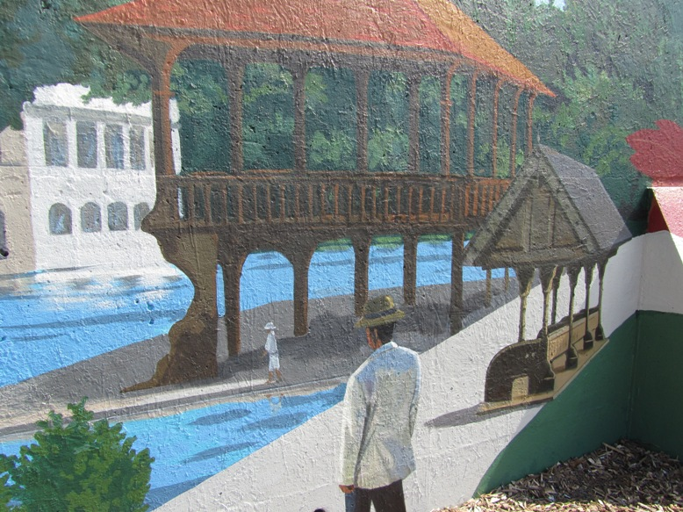

Slide 69
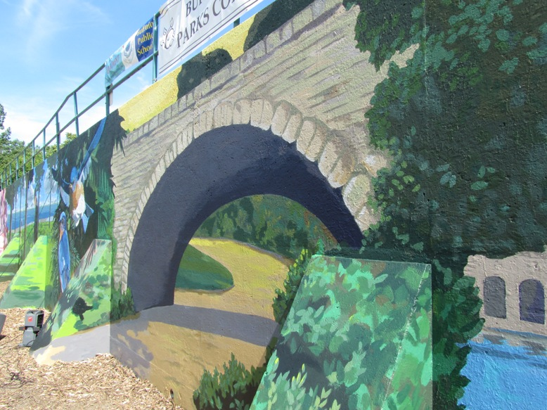

Slide 70
In Summary
Buffalo Arts Commission
Is responsible for the public art in the city
Conservation and preservation
Acquisition
Helps coordinate the arts and culturals as economic drivers for the community

Slide 71
Questions and Answers

Slide 72
Thank you
Visit us on the City of Buffalo website
under City Departments
www.ci.buffalo.ny.us

