Slide 1
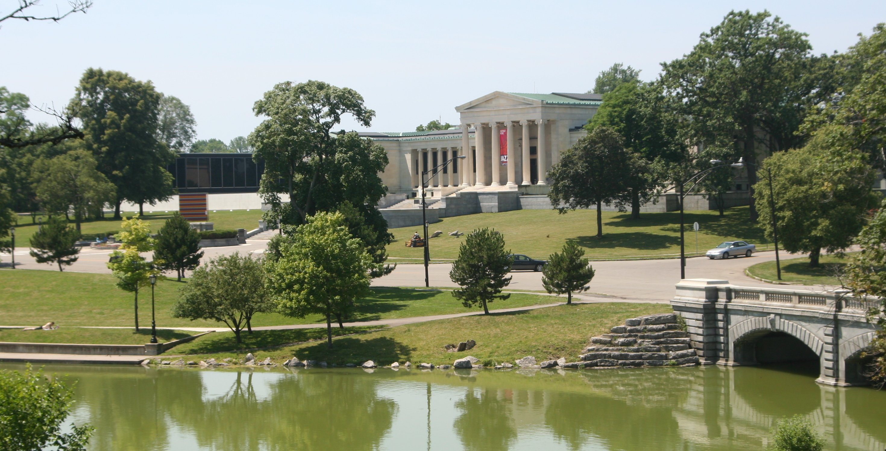
Understanding Cultural Planning
Considering a Cultural Plan for Erie and Niagara Counties
Impact and Issues
Presented to the Greater Buffalo Cultural Alliance Advisory Committee, July, 2012
Prepared by Ted Pietrzak + Associates

Slide 2
Understanding Cultural Planning
Cultural planning is a way of looking at all aspects of a community’s cultural life as community assets.
Cultural planning considers the increased and diversified benefits these assets could bring to the community in the future, if planned for strategically.
CULTURAL PLANNING TOOLKIT:
A Partnership between 2010 Legacies Now and Creative City Network of Canada

Slide 3
Why is a plan important?
Declares the importance of arts and culture and the public right of access,
Planning process engages the public and diverse sectors of the community,
Create an action plan addressing sectors that strengthen the arts and cultural sector
Integrates government policies and planning
Creates a mechanism that sustains action and addresses new issues as they may arise,
Broadens support and creates partnerships

Slide 4
Why is a plan important?
Declares the importance of arts and culture and the public right of access,
Planning process engages the public and diverse sectors of the community,
Create an action plan addressing sectors that strengthen the arts and cultural sector
Integrates government policies and planning
Creates a mechanism that sustains action and addresses new issues as they may arise,
Broadens support and creates partnerships

Slide 5
Why is a plan important?
Declares the importance of arts and culture and the public right of access,
Planning process engages the public and diverse sectors of the community,
Create an action plan addressing sectors that strengthen the arts and cultural sector
Integrates government policies and planning
Creates a mechanism that sustains action and addresses new issues as they may arise,
Broadens support and creates partnerships

Slide 6
Why is a plan important?
Declares the importance of arts and culture and the public right of access,
Planning process engages the public and diverse sectors of the community,
Creates an action plan addressing various sectors that strengthen arts and culture,
Integrates government policies and planning
Creates a mechanism that sustains action and addresses new issues as they may arise,
Broadens support and creates partnerships

Slide 7
Why is a plan important?
Declares the importance of arts and culture and the public right of access,
Planning process engages the public and diverse sectors of the community,
Create an action plan addressing various sectors that strengthen arts and culture,
Integrates government policies and planning,
Creates a mechanism that sustains action and addresses new issues as they may arise,
Broadens support and creates partnerships

Slide 8
Why is a plan important?
Declares the importance of arts and culture and the public right of access,
Planning process engages the public and diverse sectors of the community,
Create an action plan addressing various sectors that strengthen arts and culture,
Integrates government policies and planning,
Creates a mechanism that sustains action and addresses new issues as they may arise,
Broadens support and creates partnerships

Slide 9
Why is a plan important?
Declares the importance of arts and culture and the public right of access,
Planning process engages the public and diverse sectors of the community,
Create an action plan addressing various sectors that strengthen the arts and culture,
Integrates government policies and planning
Creates a mechanism that sustains action and addresses new issues as they may arise and,
Broadens support and creates partnerships.

Slide 10
What’s in a Cultural Plan?

Slide 11
What’s in a Cultural Plan?
Declaring the importance of arts
And culture
Description of the community
Consultation process
The vision
The principles
Strategic areas of focus
A work plan

Slide 12
What’s in a Cultural Plan?
Declaring the importance of arts
And culture
Description of the community
Consultation process
The vision
The principles
Strategic areas of focus
A work plan

Slide 13
What in a Cultural Plan?
Declaring the importance of arts
And culture
Description of the community
Consultation process
The vision
The principles
Strategic areas of focus
A work plan

Slide 14
What in a Cultural Plan?
Initiated by City or Regional Entity or a Foundation or a combination
Declaring the importance of arts
And culture
Description of the community
Consultation process
The vision
The principles
Strategic areas of focus
A work plan

Slide 15
What in a Cultural Plan?
Initiated by City or Regional Entity or a Foundation or a combination
Declaring the importance of arts
And culture
Description of the community
Consultation process
The vision
The principles
Strategic areas of focus
A work plan
Coordinated by the City or a committee or a combination

Slide 16
What in a Cultural Plan?
Initiated by City or Regional Entity or a Foundation or a combination
Declaring the importance of arts
And culture
Description of the community
Consultation process
The vision
The principles
Strategic areas of focus
A work plan
Coordinated by the City or a committee or a combination
Managed by a City department or a consultant

Slide 17
What in a Cultural Plan?
Initiated by City or Regional Entity or a Foundation or a combination
Declaring the importance of arts
And culture
Description of the community
Consultation process
The vision
The principles
Strategic areas of focus
A work plan
Coordinated by the City or a committee or a combination
Managed by a City department or a consultant
Taking 9 to 24 months

Slide 18
What in a Cultural Plan?
Initiated by City or Regional Entity or a Foundation or a combination
Declaring the importance of arts
And culture
Description of the community
Consultation process
The vision
The principles
Strategic areas of focus
A work plan
Coordinated by the City or a committee or a combination
Involving hundreds of people and dozens of organizations
Managed by a City department or a consultant
Taking 9 to 24 months

Slide 19
What in a Cultural Plan?
Initiated by City or Regional Entity or a Foundation or a combination
Declaring the importance of arts
And culture
Description of the community
Consultation process
The vision
The principles
Strategic areas of focus
A work plan
Funded by a government body,
a foundation or corporation or a combination
Coordinated by the City or a committee or a combination
Involving hundreds of people and dozens of organizations
Managed by a City department or a consultant
Taking 9 to 24 months

Slide 20
What in a Cultural Plan?
Initiated by City or Regional Entity or a Foundation or a combination
Declaring the importance of arts
And culture
Description of the community
Consultation process
The vision
The principles
Strategic areas of focus
A work plan
Funded by a government body,
a foundation or corporation or a combination
Coordinated by the City or a committee or a combination
Involving hundreds of people and dozens of organizations
Managed by a City department or a consultant
Taking 9 to 24 months

Slide 21
What’s in a Cultural Plan?
Declaring the importance of arts
And culture
Description of the community
Consultation process
The vision
The principles
Strategic areas of focus
A work plan

Slide 22
What’s in a Cultural Plan?
Declaring the importance of arts
And culture
Description of the community
Consultation process
The vision
The principles
Strategic areas of focus
A work plan
Ensures quality of life

Slide 23
What’s in a Cultural Plan?
Declaring the importance of arts
And culture
Description of the community
Consultation process
The vision
The principles
Strategic areas of focus
A work plan
Ensures quality of life
Expands educational opportunities

Slide 24
What’s in a Cultural Plan?
Declaring the importance of arts
And culture
Description of the community
Consultation process
The vision
The principles
Strategic areas of focus
A work plan
Ensures quality of life
Expands educational opportunities
Ensures access to citizens

Slide 25
What’s in a Cultural Plan?
Declaring the importance of arts
And culture
Description of the community
Consultation process
The vision
The principles
Strategic areas of focus
A work plan
Ensures quality of life
Expands educational opportunities
Brands the city or region as vibrant
Ensures access to citizens

Slide 26
What’s in a Cultural Plan?
Declaring the importance of arts
And culture
Description of the community
Consultation process
The vision
The principles
Strategic areas of focus
A work plan
Ensures quality of life
Expands educational opportunities
Attracts cultural tourists
Brands the city or region as vibrant
Ensures access to citizens

Slide 27
What’s in a Cultural Plan?
Declaring the importance of arts
And culture
Description of the community
Consultation process
The vision
The principles
Strategic areas of focus
A work plan
Evolves a creative economy
Ensures quality of life
Expands educational opportunities
Attracts cultural tourists
Brands the city or region as vibrant
Ensures access to citizens

Slide 28
What’s in a Cultural Plan?
Declaring the importance of arts
And culture
Description of the community
Consultation process
The vision
The principles
Strategic areas of focus
A work plan
Evolves a creative economy
Ensures quality of life
Expands educational opportunities
Attracts cultural tourists
Brands the city or region as vibrant
Ensures access to citizens

Slide 29
What’s in a Cultural Plan?
Declaring the importance of arts
And culture
Description of the community
Consultation process
The vision
The principles
Strategic areas of focus
A work plan

Slide 30
What’s in a Cultural Plan?
Declaring the importance of arts
And culture
Description of the community
Consultation process
The vision
The principles
Strategic areas of focus
A work plan
“Arts and culture, in all its permutations, is the engine propelling our city towards creative vibrancy by enhancing residents’ quality of life and attracting tourists, businesses, and creative people to Austin.”

Slide 31
What’s in a Cultural Plan?
Declaring the importance of arts
And culture
Description of the community
Consultation process
The vision
The principles
Strategic areas of focus
A work plan
Support artists and
Creative industry
Support for Individual Creators
Built Environment
Creativity and Learning
Communication and Collaboration
Financial Resources
Cultural Infrastructure

Slide 32
What’s in a Cultural Plan?
Niagara Region, Canada
Declaring the importance of arts
And culture
Description of the community
Consultation process
The vision
The principles
Strategic areas of focus
A work plan

Slide 33
What’s in a Cultural Plan?
Niagara Region, Canada
Declaring the importance of arts
And culture
Description of the community
Consultation process
The vision
The principles
Strategic areas of focus
A work plan
The purpose of the Culture Plan is to create an overarching policy and planning framework including strategic directions and actions to guide Niagara Region’s support for the creative economy and development of the creative cultural sector.

Slide 34
What’s in a Cultural Plan?
Niagara Region, Canada
Declaring the importance of arts
And culture
Description of the community
Consultation process
The vision
The principles
Strategic areas of focus
A work plan
Broad view of culture include arts, environment, cuisine, recreation, etc. focusing on;
Creative economy,
Creative places,
Creative people and,
Creative identity

Slide 35
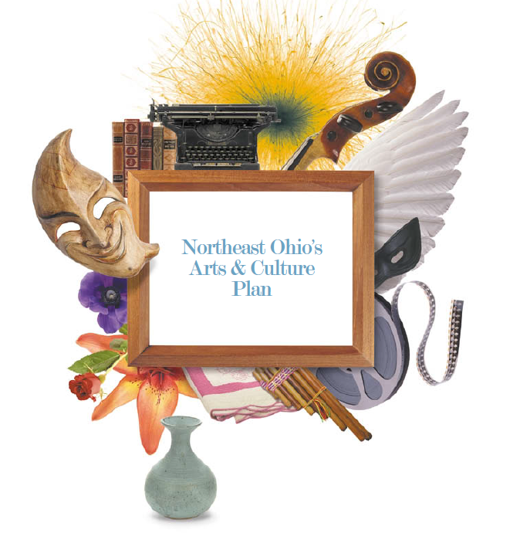
What’s in a Cultural Plan?
Declaring the importance of arts
And culture
Description of the community
Consultation process
The vision
The principles
Strategic areas of focus
A work plan

Slide 36
What’s in a Cultural Plan?
Declaring the importance of arts
And culture
Description of the community
Consultation process
The vision
The principles
Strategic areas of focus
A work plan
A regional plan, the
Commission said, was “the most critical requirement for sustaining our cultural institutions.”

Slide 37
What’s in a Cultural Plan?
Declaring the importance of arts
And culture
Description of the community
Consultation process
The vision
The principles
Strategic areas of focus
A work plan
Access
Learning
Partnerships
Resources

Slide 38
What’s in a Cultural Plan?
Declaring the importance of arts
And culture
Description of the community
Consultation process
The vision
The principles
Strategic areas of focus
A work plan

Slide 39
What’s in a Cultural Plan?
Declaring the importance of arts
And culture
Description of the community
Consultation process
The vision
The principles
Strategic areas of focus
A work plan
Greater Toledo aspires to be a world-renowned community that supports high quality arts and
cultural experiences that are affordable and accessible to all.

Slide 40
What’s in a Cultural Plan?
Declaring the importance of arts
And culture
Description of the community
Consultation process
The vision
The principles
Strategic areas of focus
A work plan
Priorities for the Arts and Culture in Greater Toledo
A. Collaboration
B. Leadership
C. Prosperity
D. Visibility
E. Spaces and Facilities

Slide 41
What’s in a Cultural Plan?
Declaring the importance of arts
And culture
Description of the community
Consultation process
The vision
The principles
Strategic areas of focus
A work plan

Slide 42
What in a Cultural Plan?
Declaring the importance of arts
And culture
Description of the community
Consultation process
The vision
The principles
Strategic areas of focus
A work plan
“Because culture is the cornerstone upon which vibrant resilient, competitive and creative industries are built, the City is committed to supporting the growth and diversity of cultural activities and offerings in Vancouver.

Slide 43
What’s in a Cultural Plan?
Declaring the importance of arts
And culture
Description of the community
Consultation process
The vision
The principles
Strategic areas of focus
A work plan
Artists and the
Creative Economy
Innovation
Learning
Connecting People, ideas and Communities
Neighborhoods
Valued and Valuable

Slide 44
What’s in a Cultural Plan?
Declaring the importance of arts
And culture
Description of the community
Consultation process
The vision
The principles
Strategic areas of focus
A work plan

Slide 45
What’s in a Cultural Plan?
Declaring the importance of arts
And culture
Description of the community
Consultation process
The vision
The principles
Strategic areas of focus
A work plan
Who is responsible for what
Resources are identified
Timetable is established

Slide 46
What’s in a Cultural Plan?
Declaring the importance of arts
And culture
Description of the community
Consultation process
The vision
The principles
Strategic areas of focus
A work plan
Who is responsible for what
Resources are identified
Timetable is established
Infrastructure is recommended and could be a city/regional government department, not-for-profit agency, enhanced arts council or a combination

Slide 47
What’s in a Cultural Plan?
Declaring the importance of arts
And culture
Description of the community
Consultation process
The vision
The principles
Strategic areas of focus
A work plan
Who is responsible for what
Resources are identified
Timetable is established
Infrastructure is recommended and could be a city/regional government department, not-for-profit agency, enhanced arts council or a combination

Slide 48
Challenges Facing GBAC in the Development of a Cultural Planning
How do we define culture and what should our focus be?
Whether a viable cultural plan can be created that meets the needs of widely diverse jurisdictions that include 2 counties, 2 larger cities, and many more smaller ones?
Whether funders and government leaders would agree that a Cultural Plan builds on past findings yet another cultural studies?
Whether leadership and support for the planning process could be found and sustained for several years?
Whether funding for a major study could be obtained?
Whether the fear of committing dedicated government support would deter elected leader from embarking on a plan?

Slide 49
Challenges Facing GBCA in the Development of a Cultural Plan
How do we define culture and what should our focus be?
Whether a viable cultural plan can be created that meets the needs of widely diverse jurisdictions that include 2 counties, 2 larger cities, and many more smaller ones?
Whether funders and government leaders would agree that a Cultural Plan builds on past findings yet another cultural studies?
Whether leadership and support for the planning process could be found and sustained for several years?
Whether funding for a major study could be obtained?
Whether the fear of committing dedicated government support would deter elected leader from embarking on a plan?

Slide 50
Challenges Facing GBCA in the Development of a Cultural Plan
How do we define culture and what should our focus be?
Whether a viable cultural plan can be created that meets the needs of widely diverse jurisdictions that include 2 counties, 2 larger cities, and many more smaller ones?
Whether funders and government leaders would agree that a Cultural Plan builds on past findings yet another cultural studies?
Whether leadership and support for the planning process could be found and sustained for several years?
Whether funding for a major study could be obtained?
Whether the fear of committing dedicated government support would deter elected leader from embarking on a plan?

Slide 51
Challenges Facing GBCA in the Development of a Cultural Plan
How do we define culture and what should our focus be?
Whether a viable cultural plan can be created that meets the needs of widely diverse jurisdictions that include 2 counties, 2 larger cities, and many more smaller ones?
Whether funders and government leaders would agree that a Cultural Plan builds on past findings yet not another cultural studies?
Whether leadership and support for the planning process could be found and sustained for several years?
Whether funding for a major study could be obtained?
Whether the fear of committing dedicated government support would deter elected leader from embarking on a plan?

Slide 52
Challenges Facing GBCA in the Development of a Cultural Plan
How do we define culture and what should our focus be?
Whether a viable cultural plan can be created that meets the needs of widely diverse jurisdictions that include 2 counties, 2 larger cities, and many more smaller ones?
Whether funders and government leaders would agree that a Cultural Plan builds on past findings yet not another cultural studies?
Whether leadership and support for the planning process could be found and sustained for several years?
Whether funding for a major study could be obtained?
Whether the fear of committing dedicated government support would deter elected leader from embarking on a plan?

Slide 53
Challenges Facing GBCA in the Development of a Cultural Plan
How do we define culture and what should our focus be?
Whether a viable cultural plan can be created that meets the needs of widely diverse jurisdictions that include 2 counties, 2 larger cities, and many more smaller ones?
Whether funders and government leaders would agree that a Cultural Plan builds on past findings yet not another cultural studies?
Whether leadership and support for the planning process could be found and sustained for several years?
Whether funding for a major study could be obtained?
Whether the fear of committing dedicated government support would deter elected leader from embarking on a plan?

Slide 54
Challenges Facing GBCA in the Development of a Cultural Plan
How do we define culture and what should our focus be?
Whether a viable cultural plan can be created that meets the needs of widely diverse jurisdictions that include 2 counties, 2 larger cities, and many more smaller ones?
Whether funders and government leaders would agree that a Cultural Plan builds on past findings yet not another cultural studies?
Whether leadership and support for the planning process could be found and sustained for several years?
Whether funding for a major study could be obtained?
Whether the fear of committing dedicated government support would deter elected leader from embarking on a plan?

Slide 55
Challenges Facing GBCA in the Development of a Cultural Plan
How do we define culture and what should our focus be?
Whether a viable cultural plan can be created that meets the needs of widely diverse jurisdictions that include 2 counties, 2 larger cities, and many more smaller ones?
Whether funders and government leaders would agree that a Cultural Plan builds on past findings yet not another cultural studies?
Whether leadership and support for the planning process could be found and sustained for several years?
Whether funding for a major study could be obtained?
Whether the fear of committing dedicated government support would deter elected leader from embarking on a plan?

Slide 56
Opportune Environment for the Creation of a Cultural Plan Now
A number of existing studies and plans set the stage for a comprehensive plan,
An improving economy,
A more widely held belief that cultural is part solution for economic renewal of the greater region,
GBCA is respected and could be recognized as the driver,
An Erie County Executive and Mayor of Niagara Falls that understand the importance of cultural institutions and attractions and,
Possible funding opportunities through NSYCA

Slide 57
Opportune Environment for the Creation of a Cultural Plan Now
A number of existing studies and plans set the stage for a comprehensive plan,
An improving economy,
A more widely held belief that cultural is part solution for economic renewal of the greater region,
GBCA is respected and could be recognized as the driver,
An Erie County Executive and Mayor of Niagara Falls that understand the importance of cultural institutions and attractions and,
Possible funding opportunities through NSYCA

Slide 58
Opportune Environment for the Creation of a Cultural Plan Now
A number of existing studies and plans set the stage for a comprehensive plan,
An improving economy,
A more widely held belief that cultural is part solution for economic renewal of the greater region,
GBCA is respected and could be recognized as the driver,
An Erie County Executive and Mayor of Niagara Falls that understand the importance of cultural institutions and attractions and,
Possible funding opportunities through NSYCA

Slide 59
Opportune Environment for the Creation of a Cultural Plan Now
A number of existing studies and plans set the stage for a comprehensive plan,
An improving economy,
A more widely held belief that culture is part of the solution for the economic renewal of the greater region,
GBCA is respected and could be recognized as the driver,
An Erie County Executive and Mayor of Niagara Falls that understand the importance of cultural institutions and attractions and,
Possible funding opportunities through NSYCA

Slide 60
Opportune Environment for the Creation of a Cultural Plan Now
A number of existing studies and plans set the stage for a comprehensive plan,
An improving economy,
A more widely held belief that culture is part of the solution for the economic renewal of the greater region,
GBCA is respected and could be recognized as the driver,
An Erie County Executive and Mayor of Niagara Falls that understand the importance of cultural institutions and attractions and,
Possible funding opportunities through NSYCA

Slide 61
Opportune Environment for the Creation of a Cultural Plan Now
A number of existing studies and plans set the stage for a comprehensive plan,
An improving economy,
A more widely held belief that culture is part of the solution for the economic renewal of the greater region,
GBCA is respected and could be recognized as the driver,
An Erie County Executive and Mayor of Niagara Falls that understand the importance of cultural institutions and attractions and,
Possible funding opportunities through NSYCA

Slide 62
Opportune Environment for the Creation of a Cultural Plan Now
A number of existing studies and plans set the stage for a comprehensive plan,
An improving economy,
A more widely held belief that culture is part of the solution for the economic renewal of the greater region,
GBCA is respected and could be recognized as the driver,
An Erie County Executive and Mayor of Niagara Falls that understand the importance of cultural institutions and attractions and,
Possible funding opportunities through NSYCA

Slide 63
Opportune Environment for the Creation of a Cultural Plan Now
A number of existing studies and plans set the stage for a comprehensive plan,
An improving economy,
A more widely held belief that culture is part of the solution for the economic renewal of the greater region,
GBCA is respected and could be recognized as the driver,
An Erie County Executive and Mayor of Niagara Falls that understand the importance of cultural institutions and attractions and,
Possible funding opportunities through NSYCA.

Slide 64
Understanding Cultural Planning
Cultural planning provides a new or different
lens for looking at the community, its issues
and concerns.
CULTURAL PLANNING TOOLKIT:
A Partnership between 2010 Legacies Now and Creative City Network of Canada

